Slide 1
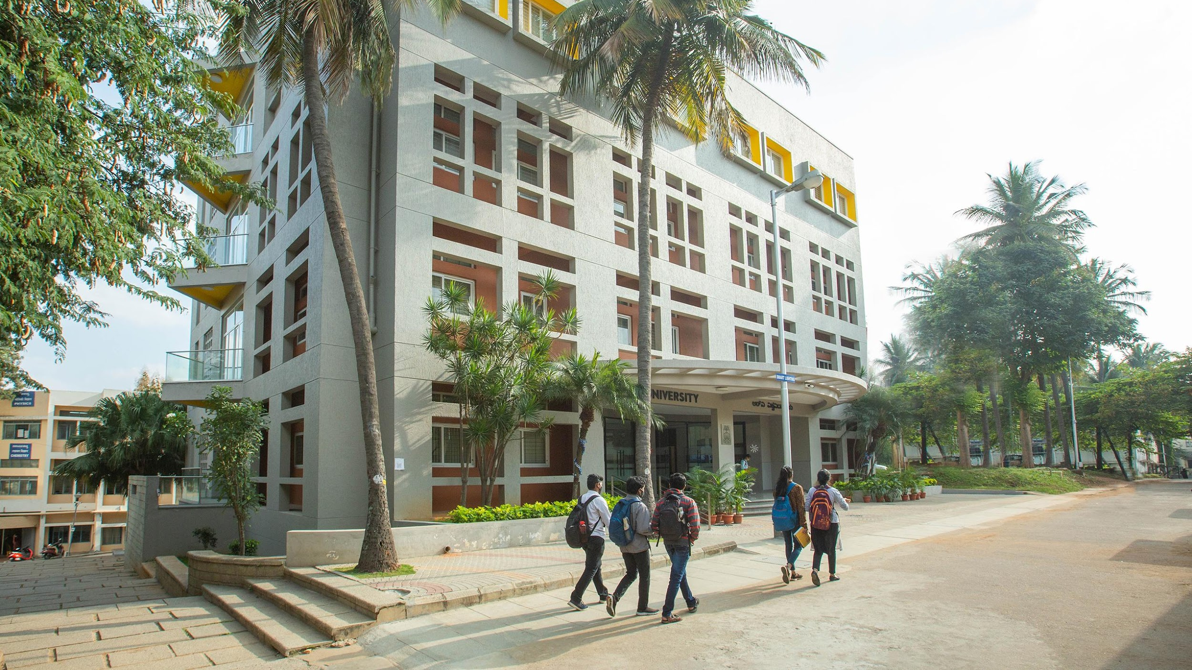

ARVR
Team
Chandana B - 1RVU22BSC018
Ananya S - 1RVU22BSC010 Ishita D S - 1RVU22BSC0136
Priyanka C M - 1RVU22BSC075

Slide 2
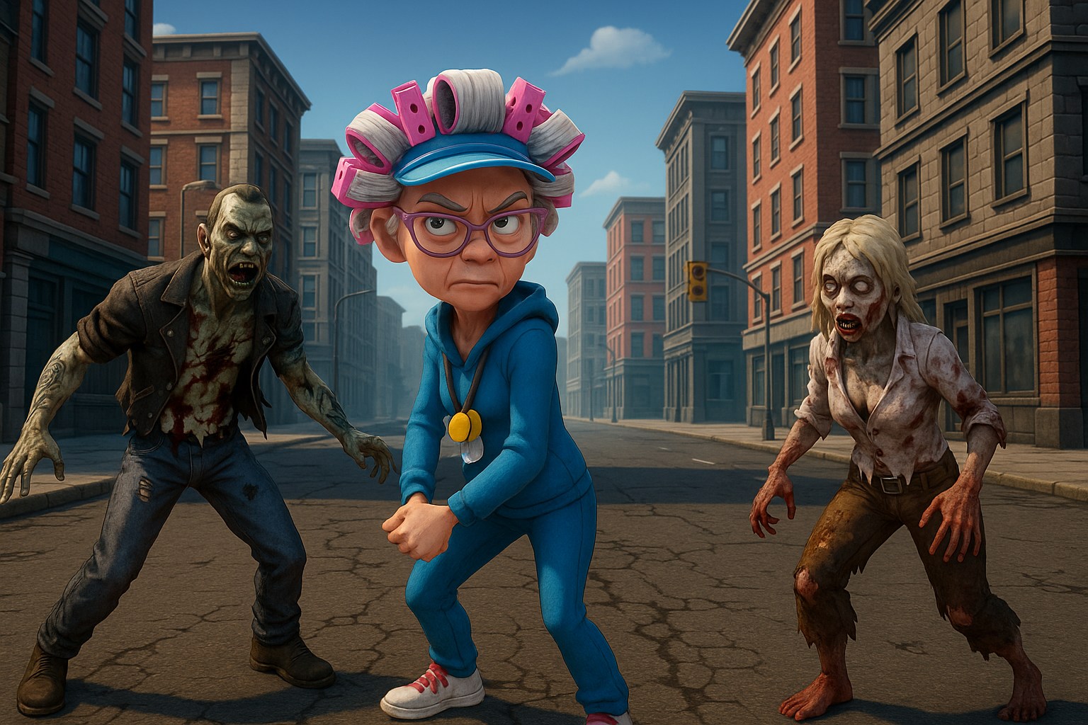
Game Introduction
🧓💥 Our Benki Granny is ready to defeat zombies and protect the world! Guide Granny through danger, collect coins, avoid zombies, and survive as long as you can!
Benki Granny

Slide 3
How to Play
🎮 Control Benki Granny using arrow keys
💰 Collect coins to increase your score
🧟‍♂️ Avoid zombies—each hit reduces your life
❤️ Game ends when life reaches zero
🔄 Try again and beat your high score!

Slide 4
Game Elements (Prefabs & Assets)
Prefabs Used:
Buildings, Roads, Nature, Props, Vehicles
Assets Setup:
3D Character with animations
Zombie and coin collection sound effects (.mp3, .wav)
Background images for Menu and Poster
Sound for zombie and coins
Materials with textures and colors
UI canvas menu

Slide 5
Scripts Overview (C#)
💻
PlayerController.cs
Handles movement, collision with coins/zombies
UIController.cs
Manages the UI interface Score(Player game menu)
AudioSource
Sound effects on collision and coins collecting.

Slide 6
AudioSource (Audio Script)
🔊Loads and plays coin collection sound
Plays zombie collision sound
Manages background music (if implemented)
Ensures non-overlapping sound playback using AudioClip
Volume control and spatial audio setup (if 3D sound is used)

Slide 7
Key Technical Components
Unity Prefab System
Character Animation + Movement
Collision Detection & Responses
Audio Management with AudioSource & Audio Clips
UI development using Unity Canvas System

Slide 8
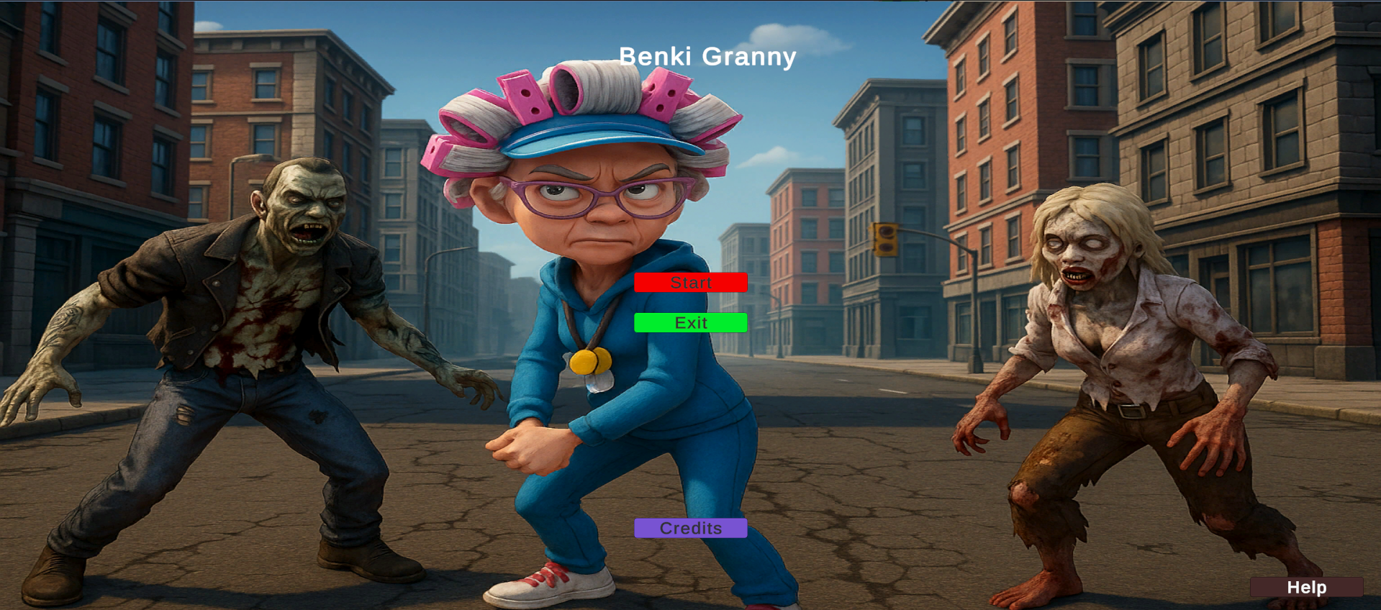
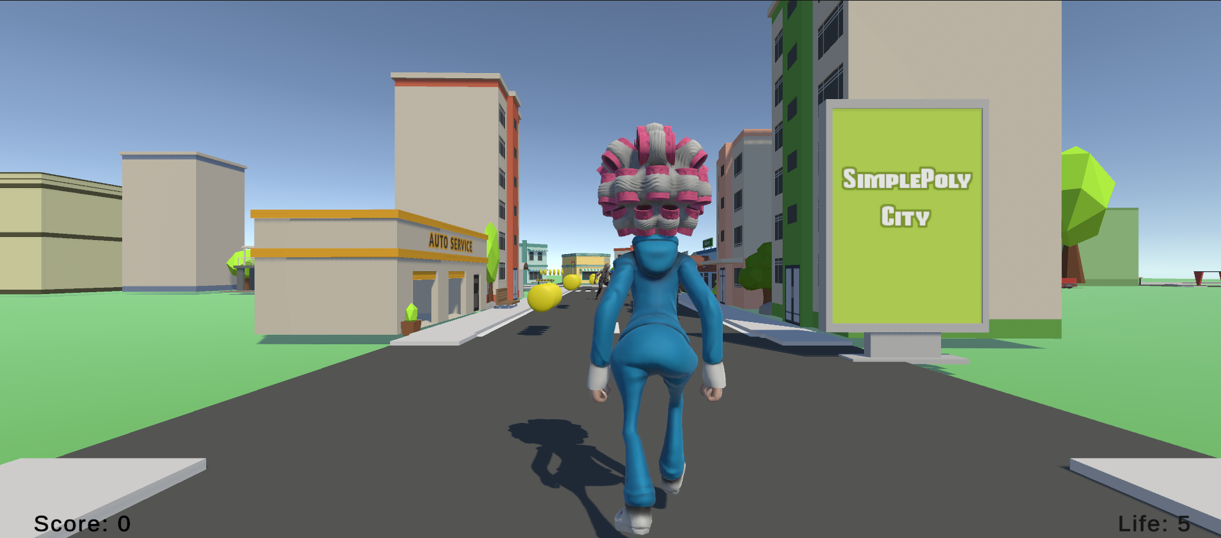

Slide 9
THANK YOU

